Slide 1
To be or not to be a… Data Scientist
A Data Science Approach to Finding a Common Definition and Skillset
Andy Ho | An Nguyen | Jodi Pafford
Dr. Robert Slater
November 1, 2019
Notes:
Andy
To be or not to be a Data Scientist? For the next 8 minutes, we’ll dive into how we used Data Science to define “who is” and “what is” a Data Scientist.

Slide 2
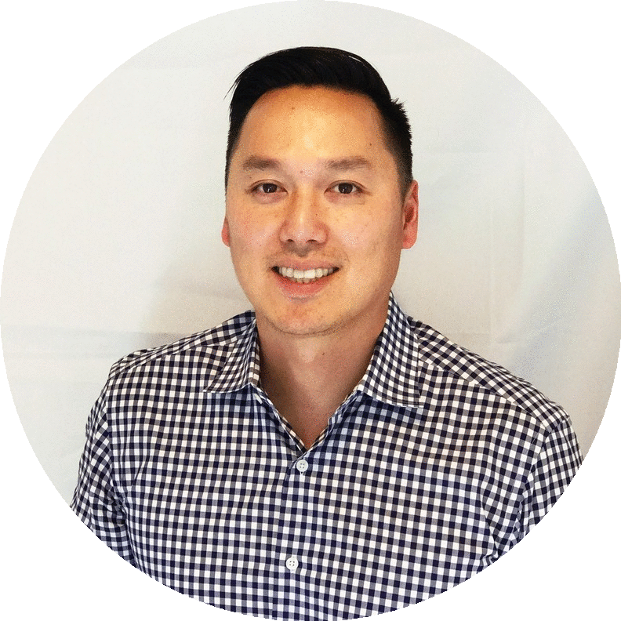
I am Data Scientist…
I am NOT a Data Scientist…
Education
BA in Economics w/minor in Computer Science
Occupation
Entrepreneur | Solutions Architect
Industry
Consumer Electronics
Insurance Technology
Andy Ho
Los Angeles, CA
Notes:
Andy – Personal Intro
My name is Andy Ho, I live in Los Angeles, CA and have been a technology entrepreneur for the last decade. Currently, I’m working on a Business Intelligence Insurtech app using Data Science techniques. Am I a Data Scientist?

Slide 3
I am a Data Scientist…
I am NOT a Data Scientist…
Education
BA in Fine Art
MA in Math Curriculum and Instruction
Occupation
Progress Monitoring and Innovation Manager
Industry
Education
Jodi Pafford
Aurora, CO
Notes:
Team – Personal Intro

Slide 4
I am a Data Scientist…
I am NOT a Data Scientist…
Education
BS in Biology
MS in Biochemical Engineering
Occupation
Quality Control Analyst
Industry
Pharmaceuticals
Medical Devices
An Nguyen
Grand Prairie, TX
Notes:
Team – Personal Intro

Slide 5

Crowd Survey: Are you a Data Scientist?
Clap your hands if you are…
Data Scientist
Not a Data Scientist
Not Sure
Notes:
Andy
Alright, so let’s hear from y’all. Clap once if you’re a data scientist! Clap twice if you’re not a data scientist! K…and if you’re not sure, clap three times!

Slide 6
Statistician
Software Engineer
Data Scientist
Data Analyst
Data Engineer
Database Administrator
Notes:
Andy
The problem is there is no common definition of a data scientist! How does one know if he or she is a data scientist? I get recruiting emails on positions like data analyst, data engineer, software engineer, and DB admin. It’s a head scratcher!
For our Capstone, we solved the problem using job postings from Indeed.com on five other job titles that often gets associated with a Data Scientist.

Slide 7
Statistician
Software Engineer
Data Scientist
Data Analyst
Data Engineer
Database Administrator
Notes:
Andy
The problem is there is no common definition of a data scientist! How does one know if he or she is a data scientist? I get recruiting emails on positions like data analyst, data engineer, software engineer, and DB admin. It’s a head scratcher!
For our Capstone, we solved the problem using job postings from Indeed.com on five other job titles that often gets associated with a Data Scientist.

Slide 8

Why is this worth solving?
Employers
Level-set expectations
Assign market compensation
Post jobs accurately
Build team appropriately
Notes:
Andy
For most companies, the concept of a Data Scientist is still relatively new. The lack of clarity of who is and what is a Data Scientist leads to negative impacts for employers – specifically on whether the individual is a fit.

Slide 9

Why is this worth solving?
Individuals
Level-set job market reality
Develop more self-awareness
Build on strengths
Acknowledge weaknesses
Map Career and Education Goals
Confidence
Notes:
Andy
And for individuals, a common definition can lead to informed decisions on self-development, an understanding on what kind of data position a perspective company is looking to hire, or overall more confidence that you ARE a data scientist.

Slide 10
Common Definition
A Data Scientist codes, communicates, and collaborates - transforming data into insights using:
Statistics
Analytics
Machine Learning
Notes:
Andy – Conclusion
So let’s start with our conclusion…
A Data Scientist codes, communicates, and collaborates - transforming data into insights using SAM: Statistics, Analytics, and Machine Learning.

Slide 11






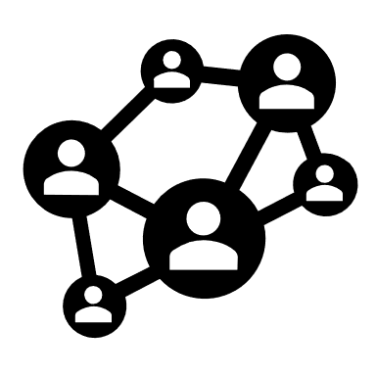

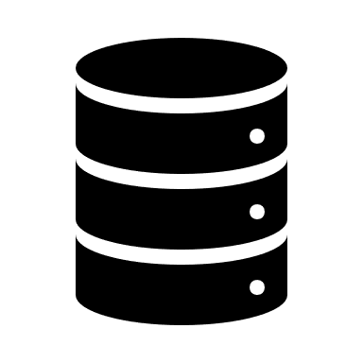

Skill Sets Possessed by Data Scientist
communication
Degree
(bachelor & masters)
Programming
insights
teams
statistics
database
research
Notes:
Andy
The top 10 features in the Data Scientist job postings were categorized under those 3 Cs: Coding, Communication, Collaboration. With a strong background in SAM.
In other words: Data science is the application SAM while SAM is the science of data.

Slide 12
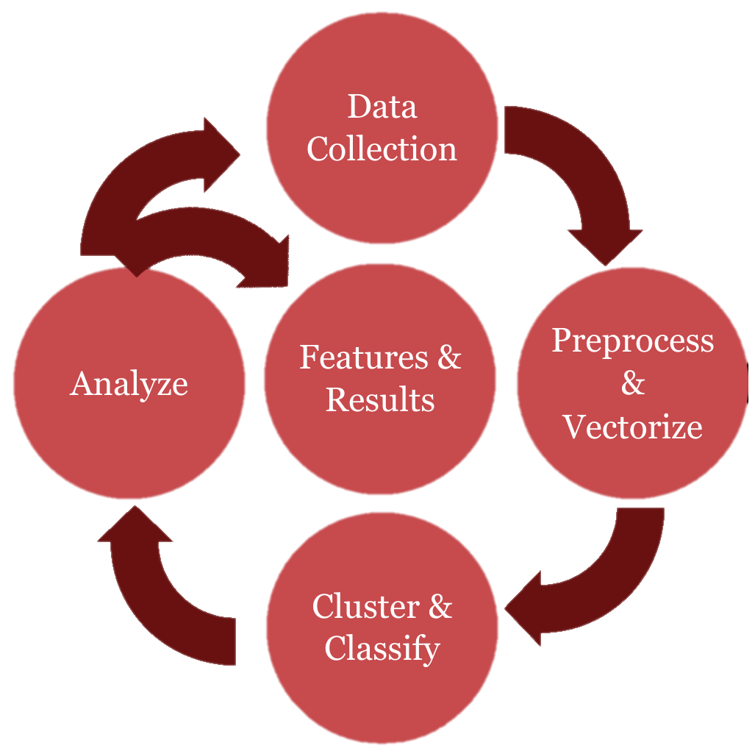
From Data Collection to Conclusion
Notes:
Andy
On a high-level, we collected and cleaned over 8000 job postings. Used TensorFlow's Universal Sentence Encoder to vectorized each job posting. Then clustered, classified, and analyzed to get the features and results for Data Scientist.

Slide 13

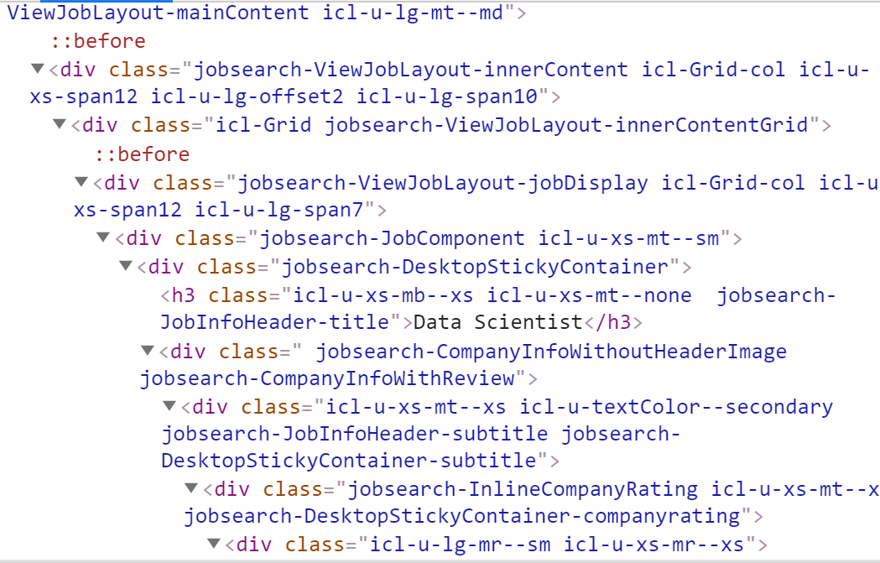
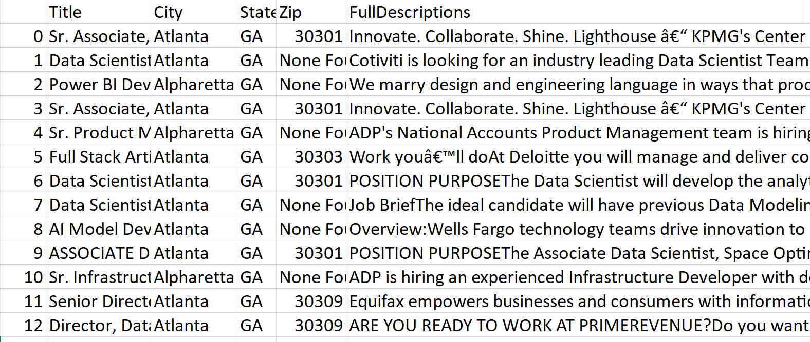
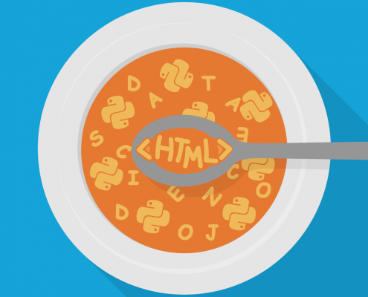
Webscrape 101
Beautiful Soup
Notes:
Jodi – How We solved it – Web Scraping
Picture credit: https://medium.com/@shivangisareen/beautiful-soup-in-python-79697b33e294

Slide 14
Contents of Data
Job Titles
Data Scientist
Data Analyst
Database Administrator
Software Engineer
Statistician
Data Engineer
Notes:
Jodi – Process – How we solved it: Collecting Data

Slide 15
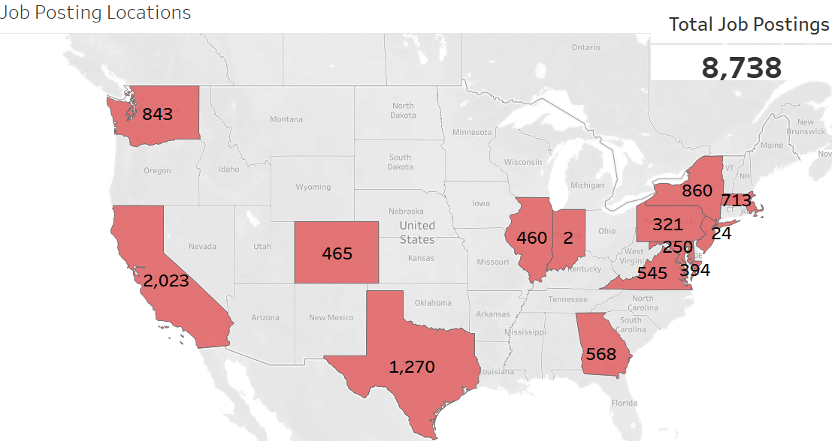
Job Distribution
Bellevue
Seattle
New York City
Chicago
Boston
Denver
Pittsburgh
Cupertino
Los Angeles
Mountain View
San Francisco
Washington, DC
Atlanta
Austin
Dallas
Houston
Notes:
Jodi – EDA – Data Collected: States, number of postings for each title.

Slide 16
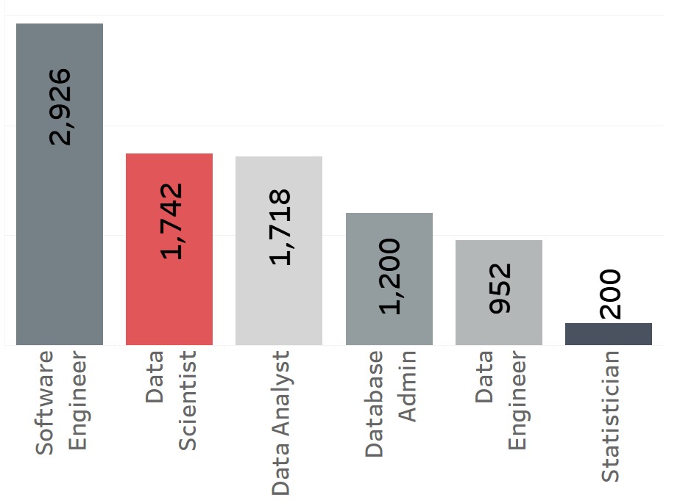
Job Distribution
Notes:
Jodi – EDA

Slide 17
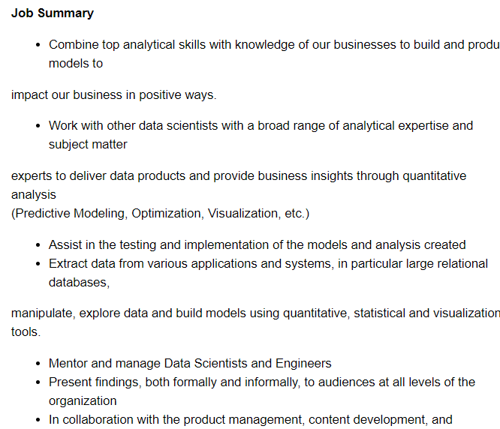
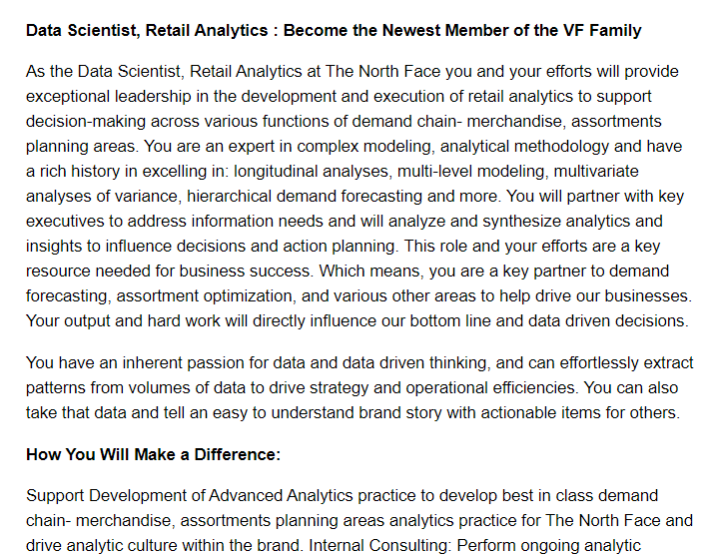

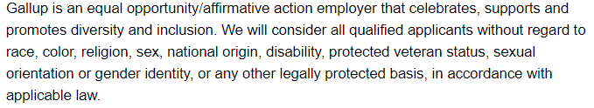
Getting Clean Data
Notes:
Jodi – Process – How we solved it: NLP Pipeline

Slide 18
Getting Clean Data
Education
Qualifications
Responsibilities
Requirements
Skills
Notes:
Jodi – Process – How we solved it: NLP Pipeline

Slide 19
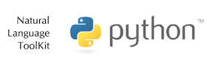



How we solved it: NLP Pipeline
words
Symbols and Line Breaks
Notes:
Jodi – Process – How we solved it: NLP Pipeline

Slide 20

Universal Sentence Encoder
Corpus
Universal Sentence Encoder
512-Dimensional
Feature Vector
Notes:
Jodi - USE

Slide 21
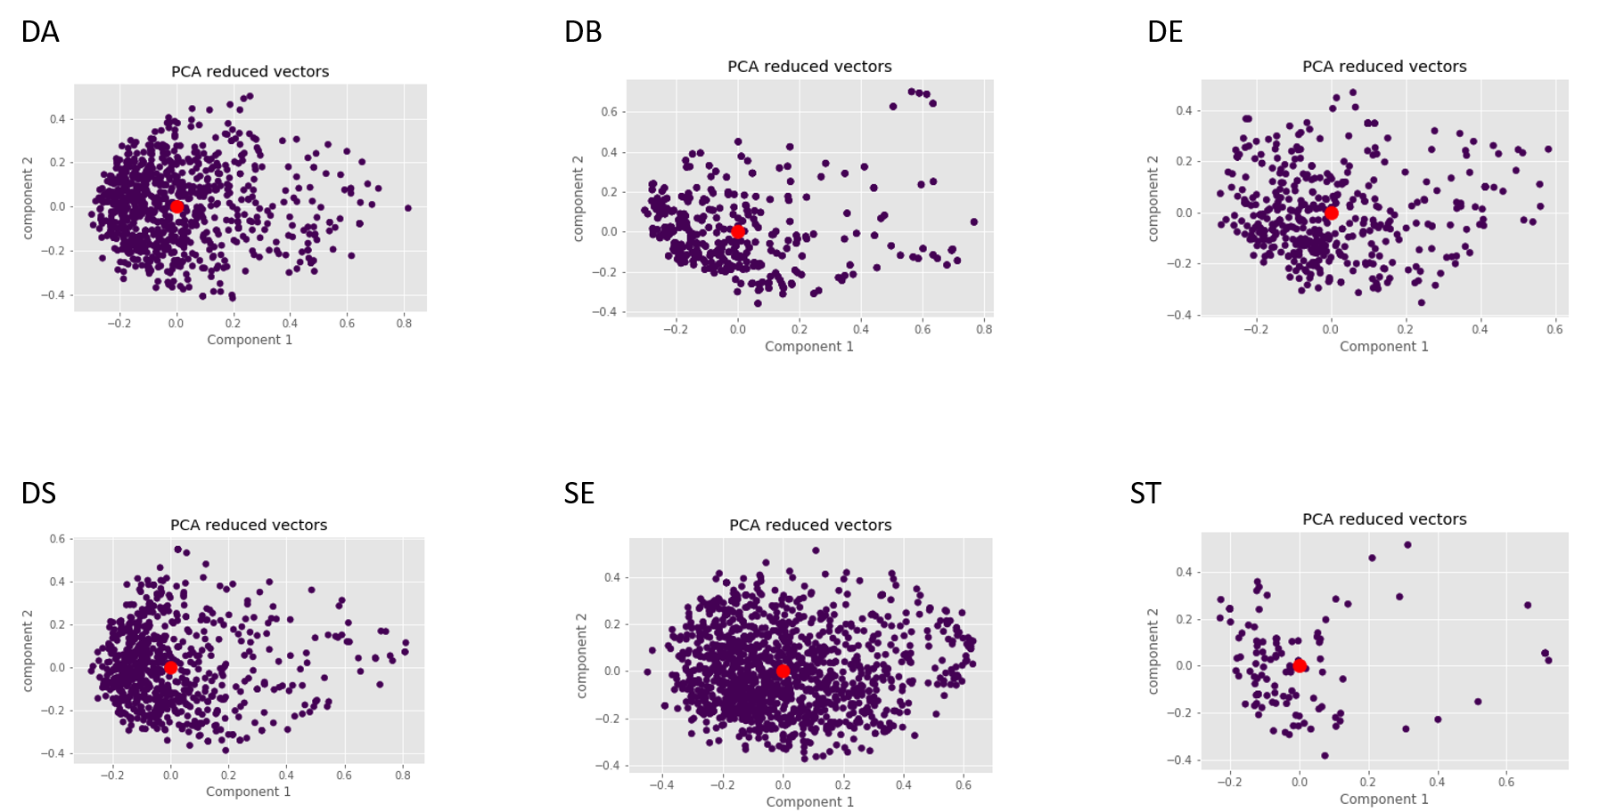
PCA used to reduce high-dimensionality
Data Engineer
Software Engineer
Data Scientist
Statistician
Data Analyst
Database Administrator
Data Analyst
Database Administrator
Data Engineer
Data Scientist
Software Engineer
Statistician
Notes:
In order to visualize the job clusters we used PCA to transform the 512 vector into a 2-dimensional space.
DA = Data Analyst
DB = Database Administrator
DE = Data Engineer
DS = Data Scientist
SE = Software Engineer
ST = Statitician

Slide 22
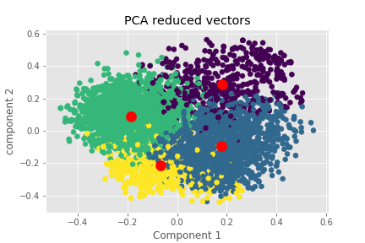
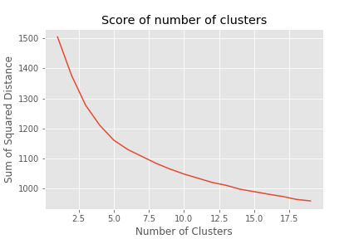
Unsupervised Clustering K-Means was inaccurate
Notes:
The vectors are combined into one dataset without labels and passed into an unsupervised clustering algorithm (K-Means). The inertia, sum of squared distance between each point and the cluster center, from different number of clusters is plotted. The elbow in the plot at 4 clusters suggests that according to the algorithm there are 4 different job clusters.

Slide 23
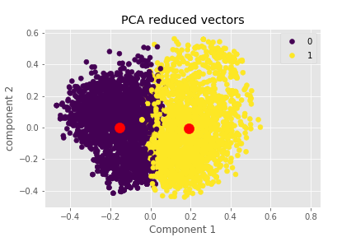
Supervised Clustering Bad Results – 50% Accurate
0 Data Scientist
1 Not Data Scientist
Notes:
Labels were then added to the dataset (Data Scientist and Not Data Scientist).
Groups were mapped by finding the greatest number of job titles in each group and normalized by number of jobs scrapped.
Accuracy was ~50%

Slide 24
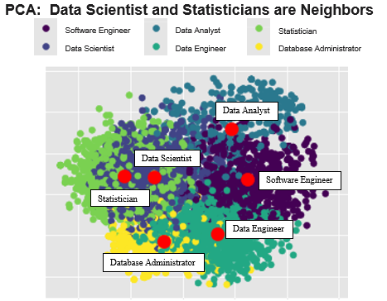
Supervised Clustering: Where is Data Engineer?
Data Analyst
Data Scientist
Software Engineer
Statistician
Software Engineer
Database Administrator
Notes:
Labels of each job titles were added to the data set.
Groups were mapped by finding the greatest number of job titles in each group and normalized by number of jobs scrapped.
Data Engineer was not found by algorithm.
Accuracy was ~50%

Slide 25
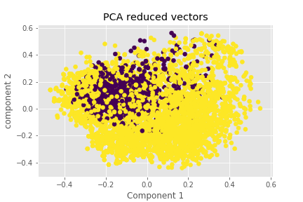
Neural Network Classification 92.5% Accurate
0 Data Scientist
1 Not Data Scientist
Prior – K-Means
Notes:
Neural Network classification, binary
Accuracy was 92.5%

Slide 26
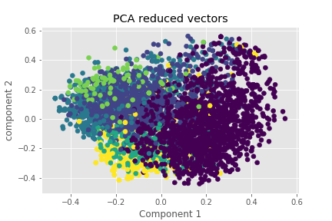
NN Supervised Classification 85% Accurate
Statistician
Data Scientist
Data Analyst
Software Engineer
Prior – K-Means
Data Engineer
Database Administrator
Notes:
Accuracy was ~80%

Slide 27
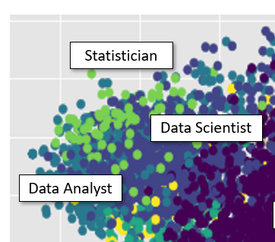
Clustering Summary
Neural Network had an acceptable accuracy rates
Data Scientists’ job posting overlaps Statistician and Data Analyst postings.
Notes:
Accuracy was ~80%

Slide 28
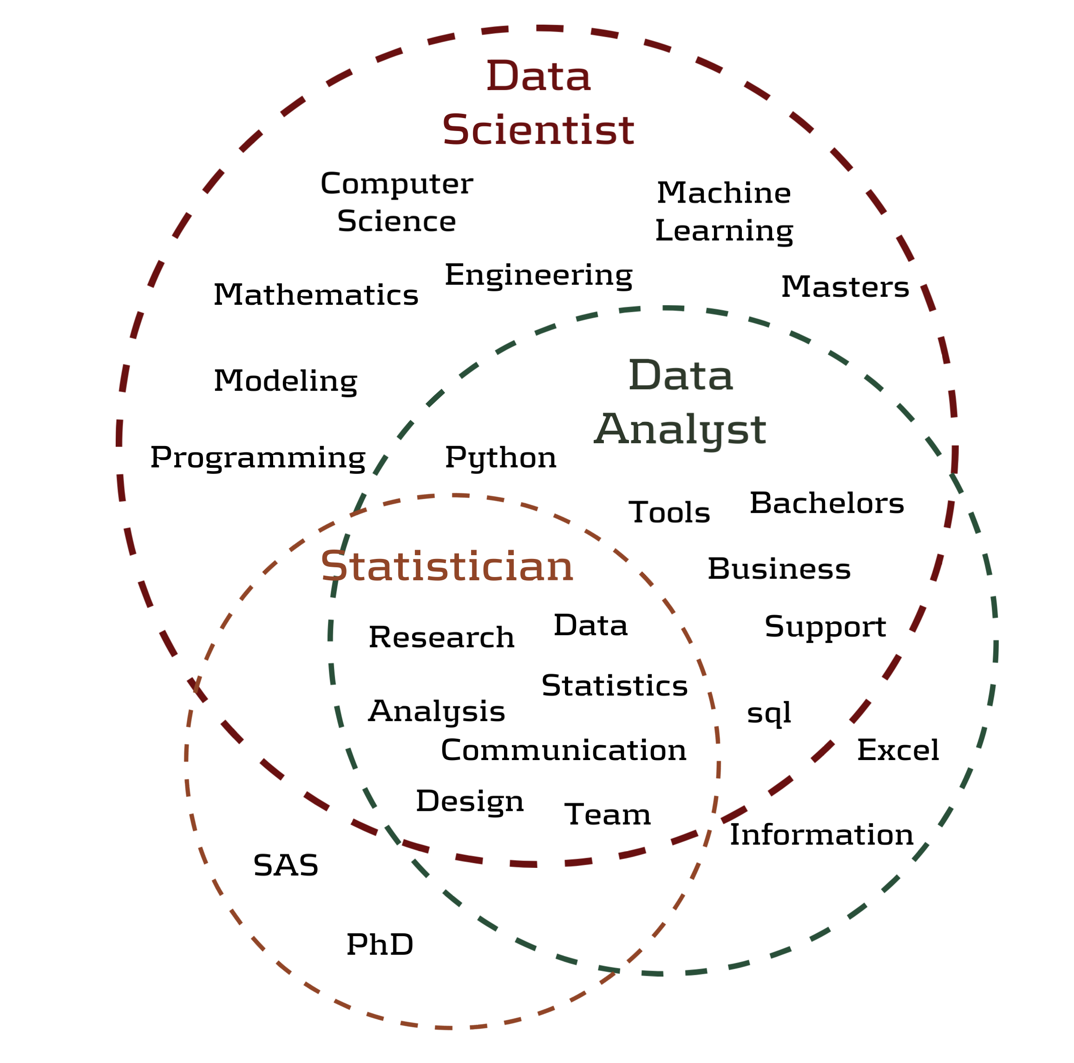
Most Common Words
Notes:
Jodi – Display Venn-Diagram

Slide 29

Most Common Words
Notes:
Jodi – Display Venn-Diagram

Slide 30

So am I a Data Scientist?
Data Scientist
Not a Data Scientist
Notes:
Jodi – Ethics

Slide 31
One last crowd survey…
Clap if you have a better understanding
DATA SCIENTIST
A Data Scientist codes, communicates, and collaborates - transforming data into insights using statistics, analytics and machine learning.
Notes:
Andy
Alright…so one last crowd survey. Clap four times if you agree with our common definition of a Data Scientist. Awesome! And clap 5 times if you disagree

Slide 32
Final Takeaway
The title “Data Scientist” is still evolving.
The 3 Cs: Code, Communicate, Collaborate.
Get to know SAM really well – Statistics, Analytics, Machine Learning
Keep up to date on the paper’s finding on our Tableau dashboard
Notes:
Andy
Lots of information to process on what is the common definition of a Data Scientist. Let me summarize a few of the points. The title is still evolving but there are some core pieces that should continue to exist for a Data Scientist. The 3-Cs: Code, Communicate, Collaborate – and Collaborate as much as possible. Get to know SAM really well. To stay up to date on our findings, be sure to check out our Tableau dashboard.

Slide 33
Final Takeaway
The title “Data Scientist” is still evolving.
The 3 Cs: Code, Communicate, Collaborate.
Get to know SAM really well – Statistics, Analytics, Machine Learning
Keep up to date on the paper’s finding on our Tableau dashboard
Notes:
Andy
Lots of information to process on what is the common definition of a Data Scientist. Let me summarize a few of the points. The title is still evolving but there are some core pieces that should continue to exist for a Data Scientist. The 3-Cs: Code, Communicate, Collaborate – and Collaborate as much as possible. Get to know SAM really well. To stay up to date on our findings, be sure to check out our Tableau dashboard.

